Slide 1
REST API
Course Code: CSC 4164
Course Title: ADVANCED PROGRAMMING WITH .NET
Dept. of Computer Science
Faculty of Science and Technology
Lecture No: | 11 | Week No: | 08 | Semester: | Fall 2020-21
Lecturer: | Victor Stany Rozario, stany@aiub.edu

Slide 2
Lecture Outline
Introduction to RESTful API, REST and HTTP
Different URIs for REST (resource and collection)
Different HTTP methods and their classification (Method Idempotence)
HATEOAS (Hypermedia as the Engine of Application State)
Different Levels of API (Richardson Maturity Model)
Introduction to ASP.NET Web API, Implementing different HTTP methods in Web API, Content Negotiation in Web API, Different media types and status codes, Receiving data from different sources (request body and request uri), Routing in Web API

Slide 3
Application Programming Interface (API)
According to Wikipedia: An application programming interface (API) is a computing interface to a software component or a system, that defines how other components or systems can use it. It defines the kinds of calls or requests that can be made, how to make them, the data formats that should be used, the conventions to follow, etc. It can also provide extension mechanisms so that users can extend existing functionality in various ways and to varying degrees.

Slide 4
Web API & ASP.NET Web API
According to Wikipedia: A Web API is an application programming interface for either a web server or a web browser. It is a web development concept, usually limited to a web application's client-side (including any web frameworks being used), and thus usually does not include web server or browser implementation details such as SAPIs or APIs unless publicly accessible by a remote web application.
The ASP.NET Web API is an extensible framework for building HTTP based services that can be accessed in different applications on different platforms such as web, windows, mobile etc. It works more or less the same way as ASP.NET MVC web application except that it sends data as a response instead of html view. It is like a webservice or WCF service but the exception is that it only supports HTTP protocol.

Slide 5
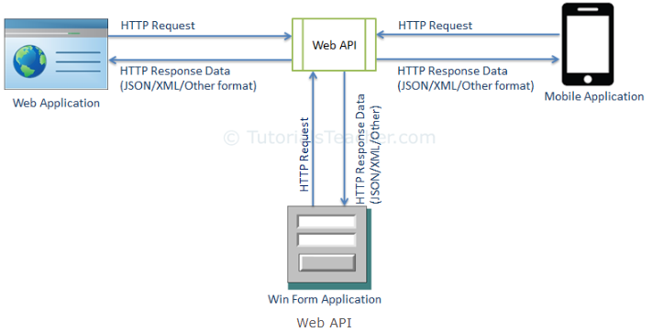
ASP.NET Web API

Slide 6
ASP.NET Web API Characteristics
ASP.NET Web API is an ideal platform for building RESTful services.
ASP.NET Web API is built on top of ASP.NET and supports ASP.NET request/response pipeline
ASP.NET Web API maps HTTP verbs to method names.
ASP.NET Web API supports different formats of response data. Built-in support for JSON, XML, BSON format.
ASP.NET Web API can be hosted in IIS, Self-hosted or other web server that supports .NET 4.0+.
ASP.NET Web API framework includes new HttpClient to communicate with Web API server. HttpClient can be used in ASP.MVC server side, Windows Form application, Console application or other apps.

Slide 7
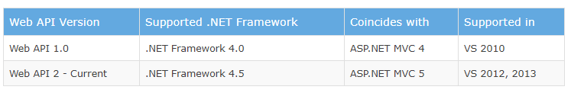
ASP.NET Web API Versions

Slide 8
ASP.NET Web API vs WCF
Web API | WCF
Open source and ships with .NET framework. | Ships with .NET framework
Supports only HTTP protocol. | Supports HTTP, TCP, UDP and custom transport protocol.
Maps http verbs to methods | Uses attributes based programming model.
Uses routing and controller concept similar to ASP.NET MVC. | Uses Service, Operation and Data contracts.
Does not support Reliable Messaging and transaction. | Supports Reliable Messaging and Transactions.
Web API can be configured using HttpConfiguration class but not in web.config. | Uses web.config and attributes to configure a service.
Ideal for building RESTful services. | Supports RESTful services but with limitations.

Slide 9
When to choose WCF?
Choose WCF if you use .NET Framework 3.5. Web API does not support .NET 3.5 or below.
Choose WCF if your service needs to support multiple protocols such as HTTP, TCP, Named pipe.
Choose WCF if you want to build service with WS-* standards like Reliable Messaging, Transactions, Message Security.
Choose WCF if you want to use Request-Reply, One Way, and Duplex message exchange patterns.

Slide 10
When to choose ASP.NET Web API?
Choose Web API if you are using .NET framework 4.0 or above.
Choose Web API if you want to build a service that supports only HTTP protocol.
Choose Web API to build RESTful HTTP based services.
Choose Web API if you are familiar with ASP.NET MVC.

Slide 11
HTTP Protocol
http is a text-based protocol. In this book, we will be dealing with requests and responses in their raw format, so you need to be familiar with how http requests and responses look. It is likely that you are already familiar with this, however, if you are not, no need to panic because it is very easy to pick up and get started with.
an http request starts with a first line containing the http verb, urL, and http version (separated by a space) and then each header in each line (\r\n ends a line). the http header is a name-value field separated by a colon (:).
after all of the headers, there is a blank line and then the payload (or body or entity) appears if there is one.
For example:
POST /api/v1/person HTTP/1.1
host: example.com
Content-Type: x-www-form-urlencoded
name=joe&surname=blogg

Slide 12
HTTP Protocol
an http response starts with the first line containing the status code and description and subsequently with headers, each in one line. then there is a blank line followed by the payload, if there is one.
For example:
201 Created
Content-Type: text/plain
Location: /api/v1/person/123
Person was successfully created

Slide 13
What is REST
REST is acronym for REpresentational State Transfer. It is architectural style for distributed hypermedia systems and was first presented by Roy Fielding in 2000 in his famous dissertation. Like any other architectural style, REST also does have it’s own 6 guiding constraints which must be satisfied if an interface needs to be referred as RESTful. These principles are listed below.
The architectural style which uses HTTP as an application protocol and hypermedia. REST is constraint driven, whereas other approaches are requirements driven. That means that REST is aware of the eight fallacies of distributed computing; the constraints of REST exist to protect an application from the effects of those fallacies.

Slide 14
REST
The eight fallacies of distributed computing are
• The network is reliable.
• Latency is zero.
• Bandwidth is infinite.
• The network is secure.
• Topology doesn’t change.
• There is one administrator.
• Transport cost is zero.
• The network is homogeneous.
REST defines six constraints a RESTful architecture needs to apply to deal with the eight fallacies of distributed computing.

Slide 15
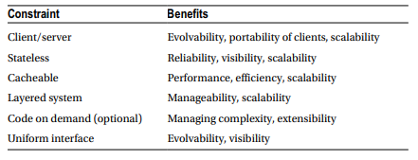
REST
Table shows the six constraints and the benefits a RESTful application gains from them.

Slide 16
Guiding Principles of REST
Client–server – The client/server constraint improves separation of concerns by separating servers from clients. That means, the client doesn’t have to deal with data storage, and so the client is allowed to evolve independent of the server. Moreover it allows the client’s software to be ported to other platforms or programming languages. On the other hand, servers don’t need to care about user interfaces to let them evolve independently. Due to the lack of complicated UI code (besides other client-side aspects), the server-side code is simpler and more scalable.
Stateless – The stateless constraint ensures that no client context is stored on the server. This constraint requires every request from any client to contain all the information necessary to process the request. All session states need to be stored on the client. The constraint embraces reliability, visibility, and scalability.
Cacheable –As is known from web browsers, clients can cache responses they receive from the servers. To prevent clients from reusing stale or inappropriate data in response to further requests, servers, implicitly or explicitly, must declare responses cacheable or not. When done right, caching may completely (certainly at least partially) make a lot of client/server interaction obsolete, with improved performance and scalability of the application being the result.

Slide 17
Guiding Principles of REST
Layered system – Adding intermediary servers, load balancers, or shared caches to the system improves overall scalability. Security might be improved by enforcing security policies. That way clients won’t be able to determine whether they are communicating with the end server.
Code on demand (optional) – REST allows client functionality to be extended by downloading and executing code in the form of applets or scripts. This simplifies clients by reducing the number of features required to be pre-implemented.
Uniform interface –The uniform interface was partially dealt with in the “Shifting to a RESTful Architecture” section in this chapter. In theory it consists of four concepts:
• identification of resources
• manipulation of resources through these representations
• self-descriptive messages
• Hypermedia as the engine of application state

Slide 18
Guiding Principles of REST
Identification of resources means that the resources of your application can be identified by URIs. The resources are separated from their representations, which are sent to the client. This means that the servers sends, for example, an XML or JSON fragment that represents a resource, such as a customer, with its properties.
Manipulation of resources through these representations means that if a client holds a representation of a customer including, for example, the metadata and has the appropriate permission, it is able to modify or delete the resource for that representation on the server.
Self-descriptive messages means that each message includes enough information to describe how to process the message. For example, the Internet media type tells the client or server how to parse the message. Another example is the indication of cacheability in server-side response (as also shown in the Cacheable constraint).
Hypermedia as the engine of application state (HATEOAS) means that after hitting a fixed entry point URI, the client navigates through the application by dynamically generated hypermedia (hypertext with hyperlinks), which the client receives within the representations of the resources from the server.

Slide 19
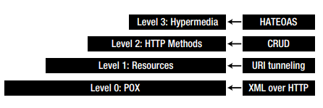
Richardson Maturity Model
As was seen in the “Shifting to a RESTful Architecture” section, we continuously improved the application from a classical service-oriented architecture using SOAP (also referred to as “plain old XML,” or POX) toward a RESTful one. The path from POX to the use of hypermedia inside the application has been described in a three-step model by Leonard Richardson, the Richardson Maturity Model, shown in Figure

Slide 20
Richardson Maturity Model
The Richardson Maturity Model describes the levels leading to a RESTful architecture, beginning at level 0, which is XML over HTTP (SOAP). Using the example from the preceding sections, it’s at level 0 because it was the base camp from which we started; it messed up HTTP methods and status codes and made no use of any improvement shown later. Each of the other three levels accounts for a step in the Richardson Maturity Model.
Level 1 embraces the use of Resources, by introducing unambiguous URIs for “customer” and “customers”.
Level 2 makes proper use of HTTP methods and status codes, both on the client and server.
By adding hypermedia (links and custom Internet media types) to the application, the peak of REST at level 3 is finally reached.

Slide 21
Richardson Maturity Model
There are a few more aspects to be seen to when planning or implementing a RESTful architecture. Some of them we’ll discover during the implementation of our sample application, as well as the implementations of ASP.NET Web API extensions in the upcoming chapters.
As has already been said, ASP.NET Web API allows you to easily embrace REST and hypermedia, but it doesn’t force you to. So if a piece of code shown in this book helps you to move toward a RESTful architecture in your application, it is marked appropriately.
Now you might ask, why should I care about REST at all?
If you’re developing a distributed application that deals with a huge number of platforms and programming languages, you should regard REST as a valid option. It is even more of a good choice if you want to support different client deployment cycles and if you’re planning to host your application in the cloud. If your application needs to deal with eventual available connectivity (think of all those mobile devices which have already entered or will someday enter the market), a RESTful implementation will lend you a hand in dealing with those issues.
Consider a RESTful application to have a network-based API instead of a library-based API.

Slide 22
HTTP Methods
To handle actions on URIs (i.e., our resources), HTTP uses so-called HTTP request methods—also referred as to “verbs.” There are a few of them, and we’ll take a look at the most important ones now.
• GET
• POST
• PUT
• DELETE
One of the HTTP request methods frequently used in web browsers is GET. GET is always used when requesting a URL like microsoft.com.

Slide 23
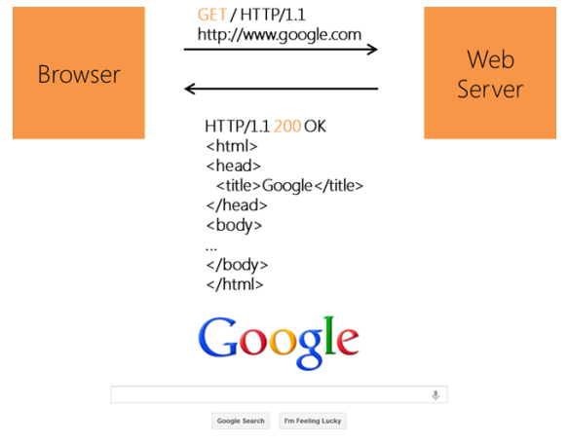
HTTP Methods

Slide 24
Safe Methods
Some methods (e.g., GET and OPTIONS) are defined as safe. That means they should not have side effects. Exceptions to that are effects such as logging, caching, and incrementing an access counter. Issuing arbitrary GET requests should therefore be considered safe if they’re not changing the application’s state. In contrast, methods such as POST, PUT, and DELETE are used for actions that do create side effects on the server; also included are subsequent external effects, such as a sent e-mail.
When it comes to implementation, you should be aware that although GET requests are called safe, their handling by the server is not technically limited in any way. As a consequence, you can write code that can very well lead to side effects on the server. In a RESTful application, you should absolutely avoid that, because it can cause problems for web caching, search engines and other automated agents, all of which rely on the safety of GET.

Slide 25
Idempotent Methods
The methods PUT and DELETE are defined as idempotent. That means that multiple identical requests should have the same effect as a single request. As HTTP is a stateless protocol, the methods being prescribed as safe (namely, GET, HEAD, OPTIONS and TRACE) should also be idempotent.
Idempotent: GET, PUT, DELETE
Non-idempotent: POST

Slide 26
HTTP Status Codes
REST APIs use the Status-Line part of an HTTP response message to inform clients of their request’s overarching result. HTTP defines forty standard status codes that can be used to convey the results of a client’s request. The status codes are divided into the five categories presented below.
CATEGORY | DESCRIPTION
1xx: Informational | Communicates transfer protocol-level information.
2xx: Success | Indicates that the client’s request was accepted successfully.
3xx: Redirection | Indicates that the client must take some additional action in order to complete their request.
4xx: Client Error | This category of error status codes points the finger at clients.
5xx: Server Error | The server takes responsibility for these error status codes.

Slide 27
Widely Used Status Codes
200 (OK)
201 (Created)
204 (No Content)
302 (Found)
400 (Bad Request)
401 (Unauthorized)
403 (Forbidden)
404 (Not Found)
500 (Internal Server Error)
501 (Not Implemented)
See the reference for more and details

Slide 28
Resource Based URIs
ALL- /employees -GET
ONE- /employees/{emp-id} -GET
CREATE - /employees -POST
EDIT- /employees/{emp-id} -PUT
DELETE- /employees/{emp-id} -DELETE
****************************************************
ALL- /departments -GET
ONE- /departments/{dept-id} -GET
CREATE - /departments -POST
EDIT- /departments/{dept-id} -PUT
DELETE- /departments/{dept-id} -DELETE
****************************************************
/departments/{dept-id}/employees -GET
/employees/{emp-id}/departments
/a/{aid}/b/{bid}/c/{cid}/d/{did}
****************************************************

Slide 29
Books
Pro ASP.NET Web API: HTTP Web Services in ASP.NET -by Tugberk Ugurlu, Alexander Zeitler, Ali Kheyrollahi
Programming ASP .Net MVC 5 – by Nimit Joshi

Slide 30
References
https://www.tutorialsteacher.com
https://docs.microsoft.com/en-us/aspnet/web-api

